Slide 1

Application Delivery Fundamentals :
Lua Proramming

Slide 2
Goals
Lua Getting Started
Numbers
Strings
Tables
Functions
The External World
Miscellaneous Topics
Closures

Slide 3
Goals
Pattern Matching
Date and Time
Bits and Bytes
Data Structures
Data Files and Serialization
Compilation, Execution, and Errors
Modules and Packages
Iterators and the Generic for

Slide 4
Lua Getting Started
Lua is a robust, lightweight, and embeddable scripting language.
It supports multiple programming methods, including procedural, object-oriented, functional, and data-driven programming.
As the primary focus on Lua is for scripting, it is rarely used as a standalone programming language.
Instead, it is used as a scripting language that can be integrated (embedded) into other programs written in mainly C and C++.
It also supports other programming languages via third-party plugins (NLua/KeraLua for .NET/C#).

Slide 5

Lua Getting Started

Slide 6
Popular use cases for Lua
As a popular component in video game and game engine development.
For example, War frame, World of Warcraft, and CRYENGINE all use Lua.
As a programming language in many network programs, like CISCO Systems, Nmap, and Mod Security.
As a programming language in industrial programs such as Adobe Lightroom and MySQL Workbench.
As a library that developers can integrate with their programs to enable scripting functionality.

Slide 7
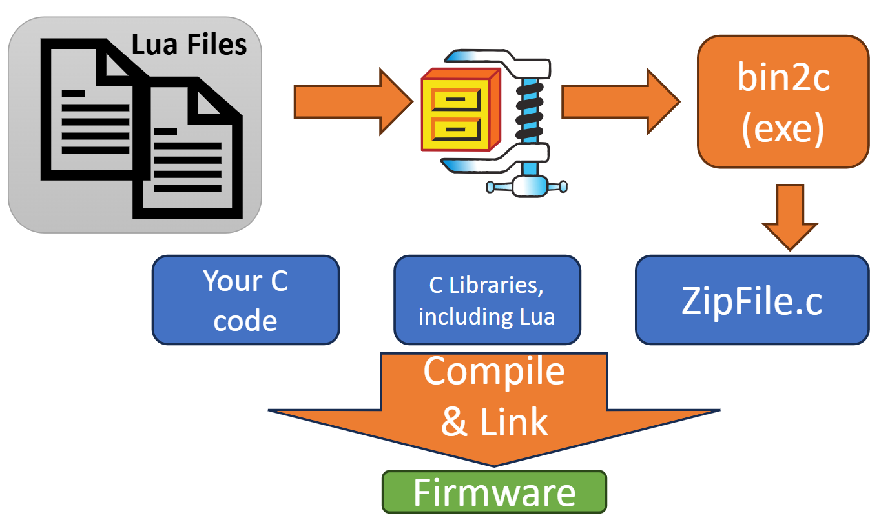
Popular use cases for Lua

Slide 8
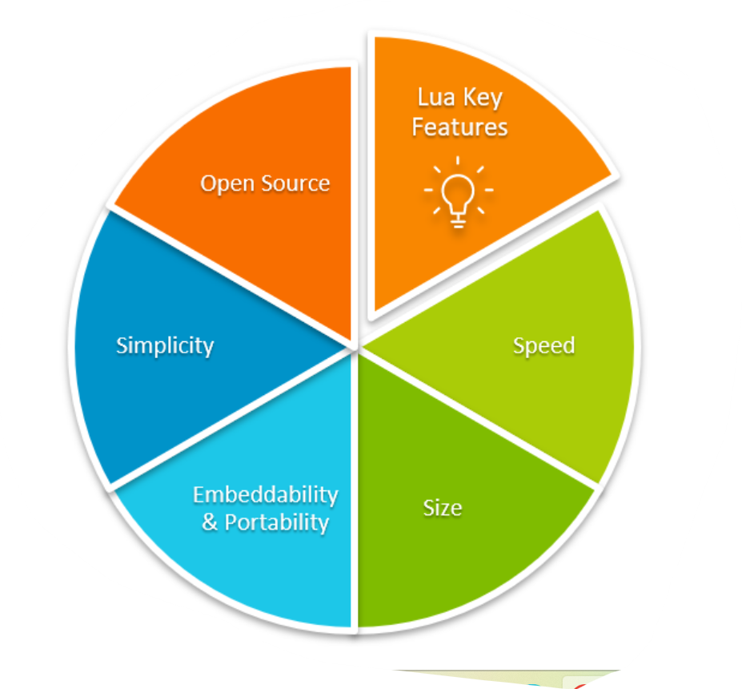
Lua Getting Started

Slide 9
Top Reasons to Use Lua
1. Lightweight and Fast
Tiny footprint (~300 KB compiled)
Written in ANSI C — extremely portable
Fast startup and execution time, ideal for embedded or real-time systems

Slide 10
Top Reasons to Use Lua
2. Embeddable in Other Applications
Easily integrates with C/C++ using Lua’s C API
Commonly used to extend functionality of applications without recompiling
Popular in games: Used by Roblox, World of Warcraft, and Adobe Lightroom

Slide 11
Top Reasons to Use Lua
3. Simple and Easy to Learn
Clean and minimalistic syntax
No unnecessary complexity or boilerplate
Perfect for scripting and quick prototyping

Slide 12
Top Reasons to Use Lua
4. Flexible and Powerful
Everything is a table (can behave like arrays, dictionaries, classes)
Supports coroutines, closures, metatables for powerful behaviors
Dynamically typed, yet safe and stable

Slide 13
Top Reasons to Use Lua
5. Cross-Platform
Runs on Windows, Linux, macOS, iOS, Android, and even microcontrollers
Just recompile Lua and it works nearly anywhere

Slide 14
Top Reasons to Use Lua
Domain | Usage Example
Gaming | Roblox, Angry Birds, WoW
IoT/Embedded | NodeMCU (ESP8266), OpenResty (Nginx)
Image/Video Tools | Adobe Lightroom, VLC, OBS
Web | Nginx with Lua scripts (OpenResty)

Slide 15
Top Reasons to Use Lua
7. Safe for Sandboxing
Lua is often used to run untrusted scripts in a sandboxed environment
Ideal for plugin systems, configuration scripts, and modding

Slide 16
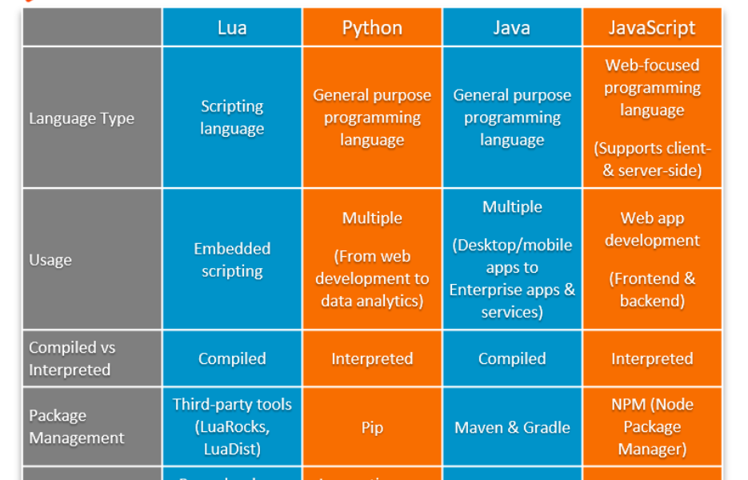
Lua vs Other Scripting Languages

Slide 17
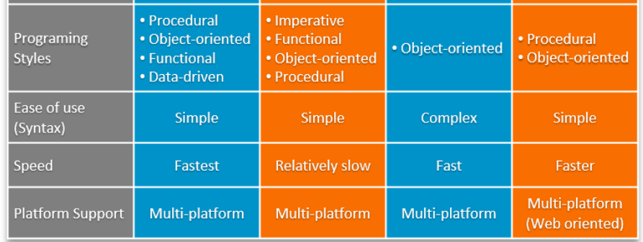
Lua vs Other Scripting Languages

Slide 18
Lua Architecture Overview
Lua Core
Lua VM
Lua Garbage Collector
Lua Standard Libraries
Lua API

Slide 19
Lua Architecture Overview
Lua consists of:
Lua Core (C library) – responsible for memory management, parsing, and execution
Lua VM (Virtual Machine) – a register-based interpreter (not stack-based)
API Layer – allows C/C++ to interact with Lua
Garbage Collector – uses incremental or generational GC
Standard Libraries – I/O, string, math, etc., built atop the core

Slide 20
Lua Architecture Overview
Lua Script (.lua)
Lua Virtual Machine (VM) | Stack based | Bytecode Interpreter
Lua Interpreter
ANSI C Runtime + Memory

Slide 21
Example: Lua Code → Compilation Flow (Source → Bytecode)
Lexer & Parser (llex.c, lparser.c)
Abstract Syntax Tree (AST)
Code Generator (lcode.c)
Bytecode (Prototype)
Lua Source Code (.lua)

Slide 22
What Is an Abstract Syntax Tree (AST)?
An AST is a tree-structured representation of source code where:
Each node represents a construct: variable, function, operator, etc.
Child nodes represent arguments, expressions, or blocks.

Slide 23
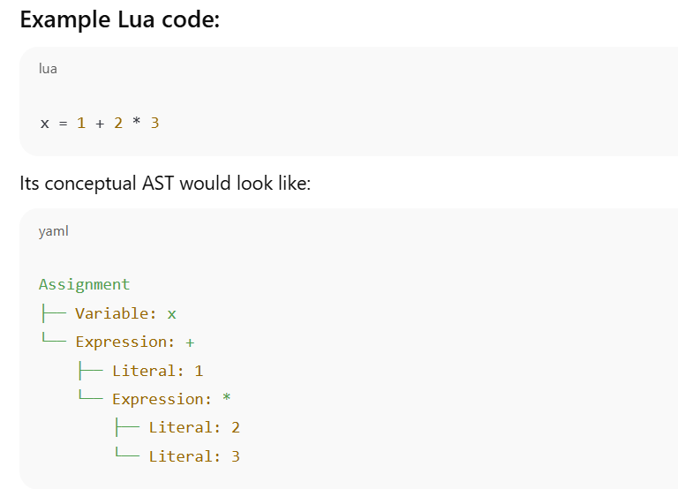
What Is an Abstract Syntax Tree (AST)?

Slide 24
Internals in Lua Source Code
AST is constructed in lparser.c
Parser produces a tree of expressions and statements
That tree is passed to lcode.c to generate bytecode
Lua doesn't keep the AST around at runtime — it is discarded after bytecode generation.

Slide 25
How to View or Generate the AST in Lua?
1. Use Metalua (for Lua 5.1)
mlc = require 'metalua.compiler'
ast = mlc:new():src_to_ast("x = 1 + 2 * 3")
require('pl.pretty').dump(ast)

Slide 26

How to View or Generate the AST in Lua?
2. Use a Lua parser written in Lua (e.g., LuaSrcDiet, luaparse)
LuaSrcDiet: Tokenizer and parser that can extract structure
luaparse (JavaScript): Parses Lua and emits an AST in JS (used in VSCode)
const luaparse = require('luaparse');
const ast = luaparse.parse('x = 1 + 2 * 3');
console.log(JSON.stringify(ast, null, 2));

Slide 27
How to View or Generate the AST in Lua?
Use Lua language servers (for tooling)
Tools like Lua Language Server internally build ASTs to power:
Syntax highlighting
Code navigation
Linting
But they don’t expose it directly unless you're modifying the server.

Slide 28
Summary
Approach | AST Access | Notes
Standard Lua | ❌ No AST exposed | AST discarded after bytecode
Metalua | ✅ Full AST access | Lua 5.1 only
luaparse (JS) | ✅ Full AST in JS | Good for tooling
Language Servers | ✅ Internal use only | For LSP features

Slide 29
Execution Flow
Write Script: write a .lua file or pass a string to luaL_loadstring.
luaL_loadstring is a function from the Lua C API (in lauxlib.h) that compiles a Lua chunk from a given C string and loads it onto the Lua stack. It doesn't execute the chunk -with lua_pcall.
Compilation to Bytecode: Lua source is compiled into intermediate bytecode by the interpreter.
Execution via Virtual Machine (VM): Lua VM is stack-based, executing bytecode instructions.
Interaction with Host Program:
Lua calls C functions (via require, ffi, etc.)
C/C++ calls Lua functions (via the C API)

Slide 30
Lua VM
The Lua Virtual Machine (Lua VM) is the core component of the Lua interpreter that executes compiled Lua bytecode.
It is a register-based virtual machine, which makes it compact and fast compared to stack-based VMs.

Slide 31
Key Features of the Lua VM
Feature | Description
Register-based | Uses registers (virtual) instead of a stack for instruction operands.
Portable | Written in ANSI C; runs on nearly all platforms.
Lightweight | Small footprint; embeddable.
Bytecode interpreter | Executes bytecode generated by the Lua compiler.

Slide 32
Lua VM Components
1. Registers
The Lua VM uses virtual registers (like R0, R1, ...) for local variables and function calls.
Each function call has its own set of registers.
2. Call Stack
Stores information about function calls (return addresses, arguments, etc.).
Managed using Call Info structures.

Slide 33
3. Lua VM Components Instruction Set (Bytecode)
Each instruction is a 32-bit value and has the format:
c
// Types:
iABC, iABx, iAsBx, iAx
// Example:
OP_ADD A B C → R[A] := R[B] + R[C]

Slide 34
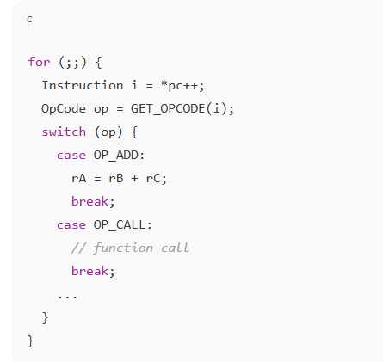
4. Lua VM Dispatch Loop
The Lua VM runs an infinite loop that fetches, decodes, and executes bytecode instructions.

Slide 35
Example: Lua Code → Bytecode
a = 10 + 20
LOADK 0 1 ; R0 = 10
LOADK 1 2 ; R1 = 20
ADD 2 0 1 ; R2 = R0 + R1

Slide 36
Common Bytecode Instructions
Opcode | Action
LOADK | Load constant into register
MOVE | Copy value between registers
ADD | Add values in two registers
CALL | Call a Lua function
RETURN | Return from function
JMP | Jump to another instruction
EQ | Compare equality

Slide 37
Lua VM (Standard Lua Interpreter)
What It Is:
The standard Lua interpreter (e.g., Lua 5.1–5.4) uses a register-based virtual machine.
It interprets bytecode generated from Lua source code.
How It Works:
Your Lua code is compiled into bytecode (Proto).
The Lua VM reads and interprets each bytecode instruction in a loop.
Functions are closures that contain bytecode and data.

Slide 38
Lua VM (Standard Lua Interpreter)
Characteristics:
Slower than native machine code execution
Portable and simple
Easier to debug
Great for scripting and embedded environments

Slide 39
Lua VM (Standard Lua Interpreter)
local x = 10
print(x + 1)
Gets compiled into instructions like LOADK, ADD, CALL (executed one by one by VM).

Slide 40
LuaJIT (Just-In-Time Compiler)
🔧 What It Is:
A high-performance implementation of Lua 5.1 with a JIT compiler.
Translates Lua bytecode into native machine code at runtime.
⚙️ How It Works:
LuaJIT starts interpreting just like the standard VM.
Hot code paths (frequently executed functions/loops) are identified.
These paths are compiled into native machine code and cached.
The next time they're run, the native code executes directly.

Slide 41
LuaJIT (Just-In-Time Compiler)
📈 Characteristics:
Much faster than standard Lua (often 5–20x)
Uses trace-based JIT (records linear paths of execution)
Retains compatibility with most Lua 5.1 code (plus some 5.2 features)

Slide 42
Lua VM (Standard Lua Interpreter)
What It Is:
The standard Lua interpreter (e.g., Lua 5.1–5.4) uses a register-based virtual machine.
It interprets bytecode generated from Lua source code.

Slide 43
Key Differences Table:
Feature | Lua VM (PUC-Rio) | LuaJIT
Execution model | Interpreted bytecode | JIT-compiles hot code to machine code
Performance | Slower | Much faster
Memory usage | Lower | Higher (due to JIT traces/cache)
Debugging | Simpler | Harder to debug native code paths
Compatibility | Lua 5.1–5.4 | Lua 5.1 (partial 5.2/FFI extensions)
Portability | Highly portable | Architecture-dependent
Used in | Embedded systems, games | Performance-critical apps, games

Slide 44
When to Use Which?
Scenario | Use
Simple scripting or embedded | Standard Lua VM
Heavy computation, game logic, or high-performance scripting | LuaJIT
Need for full Lua 5.3+ features (e.g., integers, bitwise ops) | Lua 5.3+ VM
Need for C interoperability and speed | LuaJIT (with FFI)

Slide 45
Bonus: LuaJIT’s FFI (Foreign Function Interface)
LuaJIT’s FFI allows you to call C functions directly from Lua without writing C glue code:
local ffi = require("ffi")
ffi.cdef[[ double cos(double x); ]]
print(ffi.C.cos(0)) --> 1.0

Slide 46
Optimization: Lua JIT
Lua JIT replaces the Lua VM with a JIT compiler.
Translates bytecode into native machine code on-the-fly.
Up to 10x faster than standard Lua VM in many cases.

Slide 47
Detect Lua or LuaJIT:
lua -v
# or
luajit –v

Slide 48
Detect Lua or LuaJIT:
Detect LuaJIT at runtime:
if jit then
print("Running with LuaJIT", jit.version)
else
print("Running with standard Lua", _VERSION)
end

Slide 49
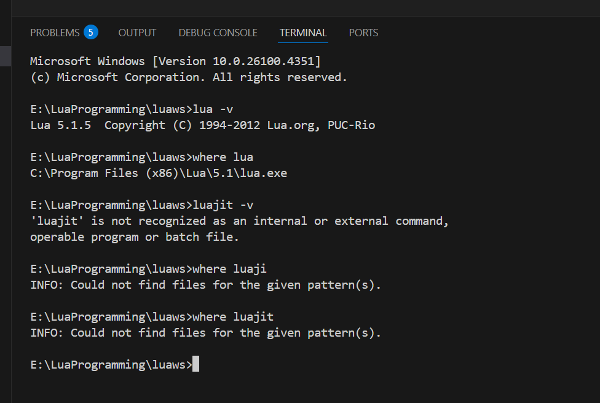
Detect Lua or LuaJIT:

Slide 50
Summary
Method | Detects | Code/Command
CLI | Interpreter type | lua -v, luajit -v
Lua code | Lua vs LuaJIT | if jit then ...
C API | Embedded interpreter | lua_getglobal(L, "_VERSION")
Executable path | Runtime being called | which lua or where lua

Slide 51
Lua Core
The Lua Core is the heart of the Lua interpreter.
It's written entirely in ANSI C, making it portable, lightweight, and embeddable.
The core includes the essential parts that power Lua's runtime and execution.

Slide 52
1. Components of Lua Core
File | Responsibility
lapi.c | Public C API implementation
lcode.c | Bytecode generator
llex.c | Lexical analyzer (tokenizer)
lparser.c | Recursive descent parser
lvm.c | Virtual machine (bytecode execution engine)
ltable.c | Hash table (table) implementation
lgc.c | Garbage collection logic
lstate.c | State machine (Lua state lua_State)
lfunc.c | Closures, function objects, upvalues
lobject.c | Value tagging, object management
lstring.c | String interning and management
lmem.c | Memory allocator wrappers

Slide 53
2. Key Data Structures
lua_State
The main execution context (like a Lua thread).
Contains:
Call stack
Global environment
Registry
Error handling info

Slide 54
2. Key Data Structures
TValue
Generic tagged value representation.
All Lua types (number, boolean, string, function, etc.) use this unified format.
typedef struct TValue {
int tt_;
union {
double n; // Number
int b; // Boolean
GCObject *gc; // Pointer to GC-managed objects
void *p; // Light userdata
} value_;
} TValue;

Slide 55
2. Key Data Structures
Table
Lua's primary data structure.
Implements both arrays and hashes using hybrid storage.
Dynamically resizes and rehashes.

Slide 56
3. How the Lua Core Executes Code Step-by-step
Lexing – llex.c:
Breaks script into tokens.
Skips whitespace/comments.
Parsing – lparser.c:
Converts tokens into an abstract syntax tree (AST).
Builds function prototypes (Proto).
Code Generation – lcode.c:
Translates AST into register-based bytecode.
Execution – lvm.c:
Executes bytecode instruction-by-instruction in Lua VM.

Slide 57
4. Garbage Collection (GC)
Managed in lgc.c:
Uses incremental or generational GC
Can be configured via the API: lua_gc
GC handles all heap-allocated objects:
Tables
Strings
Functions
User data

Slide 58
5. Lua C API Interface (lapi.c)
This is the interface for embedding Lua in C/C++.
Common functions:
lua_getglobal(L, "varname")
lua_pushnumber(L, 42)
lua_settable(L, -3)
lua_pcall(L, nargs, nresults, errfunc)
The Lua stack (virtual) is the bridge for C↔Lua interaction.

Slide 59
6. Customization & Portability
You can replace Lua's memory allocator via lua_newstate().
Can remove/replace standard libraries (base, io, os, etc.).
Lua compiles easily on any platform with a C compiler.

Slide 60
Summary: Core Responsibilities
Component | Purpose
Lexer & Parser | Tokenize and parse Lua code
CodeGen | Generate bytecode from AST
VM | Execute bytecode (register-based)
GC | Automatic memory management
C API | Allow C code to run/manipulate Lua
Tables | Backbone of Lua data structure
Functions | First-class, closures supported

Slide 61
Lua Memory Management
Lua's memory management is automatic and efficient, designed to be lightweight for embedding in applications.
It uses a garbage collector (GC) based on an incremental, generational, mark-and-sweep algorithm.

Slide 62
Lua Memory Management
Concept | Description
Automatic Memory | All memory (tables, functions, strings, etc.) is allocated dynamically.
Garbage Collector | Frees unused objects to reclaim memory.
Userdata Support | Allows C/C++ objects to be managed by Lua's GC using metatables.
Memory Limits | Memory can be tracked and limited via hooks for embedded systems.

Slide 63
Lua Memory Management - Garbage Collection Process
Marking
Start with root objects and mark all reachable objects.
Propagation
Traverse tables, closures, etc., and mark what they reference.
Pause
Wait until the next GC cycle.
Atomic
Sweeping
Final marking to handle any missed objects during propagation.
Finalization
Unreachable (unmarked) objects are freed.
Call __gc metamethods for objects with finalizers.

Slide 64
Lua Memory Management - Memory Allocation Functions
All Lua allocations go through a customizable allocator:
void *(*lua_Alloc)(void *ud, void *ptr, size_t osize, size_t nsize);
ptr: current block (NULL if allocating)
osize: old size
nsize: new size (0 means free)
You can set this allocator using lua_newstate().

Slide 65
What Lua Collects
Type | Collected? | Notes
Tables | ✅ | Even metatables are collectable
Strings | ✅ | Interned, collected if unreferenced
Functions | ✅ | Lua and C closures are managed
Userdata | ✅ | With optional __gc finalizers
Threads | ✅ | Coroutines are collectable

Slide 66
Memory Management in Embedded Systems
In embedded environments (like games or IoT), you can:
Set custom allocators to track or limit memory usage.
Use meta tables to add destructors (__gc) to complex objects.
Monitor memory usage via lua_gc() in C.

Slide 67
Source Code Pointers
File | Role
lgc.c | Implements the garbage collector
lmem.c | Memory allocator interface
lstring.c | String interning and freeing
ltable.c | Table management and resizing
lapi.c | Exposes memory functions via C API

Slide 68
Best Practices for Efficient Memory Use
Avoid
Avoid long-lived unused tables – can delay GC.
Use
Use nil to clear references (e.g., t[i] = nil).
Minimize
Minimize string creation – Lua interns strings, which takes memory.
Use
Use collect garbage wisely – especially in memory-constrained environments.
Watch
Watch closures – they retain their upvalues.

Slide 69
Lua Version History
Version | Release Year | Key Features
1.0 | 1993 | First release; simple procedural language
2.1 | 1994 | Added real functions and tag methods (early metatables)
3.0 | 1997 | Lexical scoping; improved tables
4.0 | 2000 | Better support for C API; upvalues introduced
5.0 | 2003 | Coroutines, closures, require(), improved GC
5.1 | 2006 | Module system, package, **setfenv/getfenv`, new VM
5.2 | 2011 | _ENV (lexical environments), goto, bit32, better xpcall
5.3 | 2015 | Integers, bitwise operators, utf8 lib, math.type()
5.4 | 2020 | To-be-closed variables, const, generational GC, warning system

Slide 70
Summary
Version | Most Known For
5.0 | Coroutines, closures
5.1 | Widely adopted, LuaJIT base
5.2 | _ENV, goto, bitwise ops
5.3 | Integers, UTF-8 support
5.4 | Const, close vars, GenGC

Slide 71
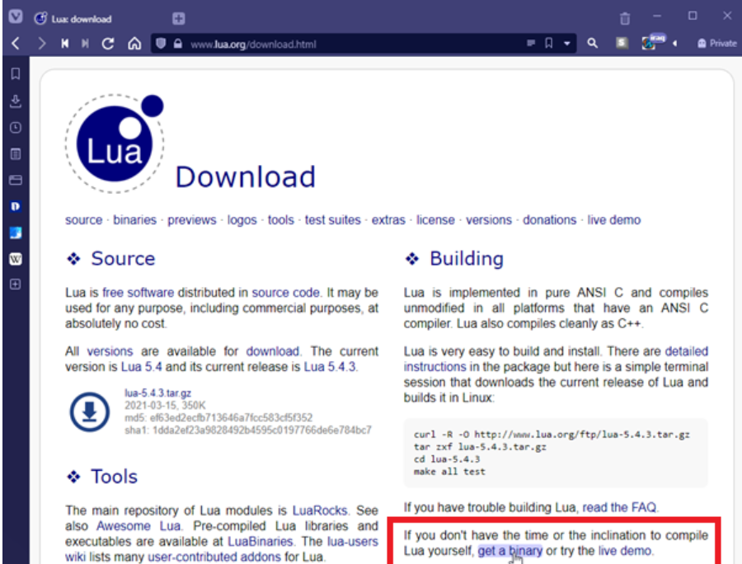
Installing Lua
Navigate to the Lua.org download page.

Slide 72
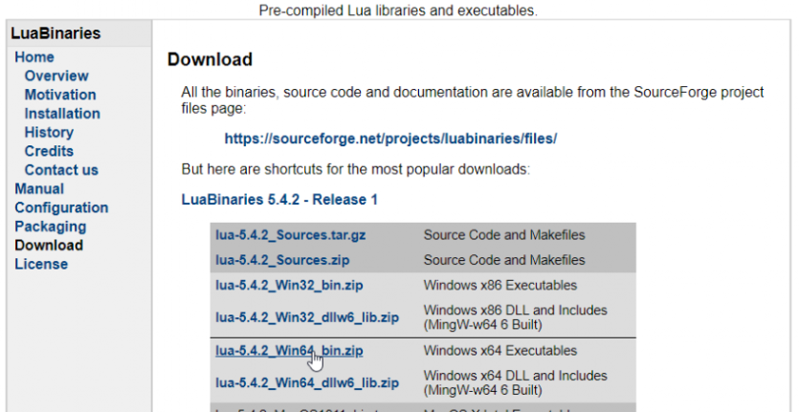
Installing Lua

Slide 73
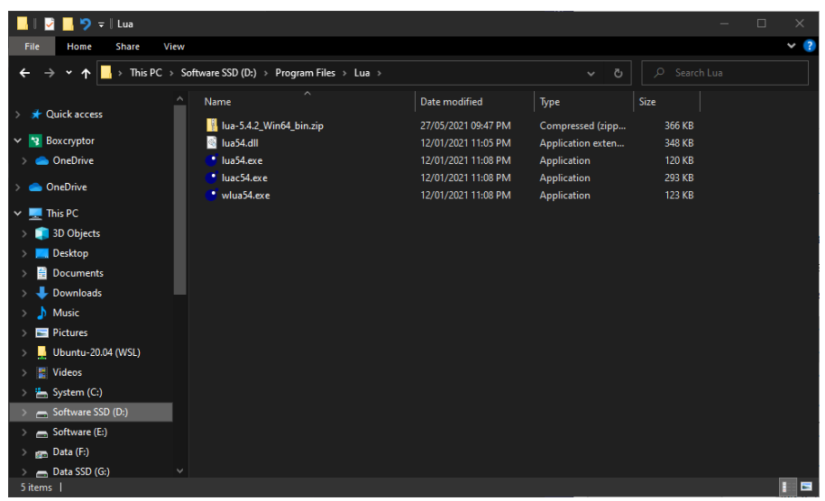
Installing Lua

Slide 74
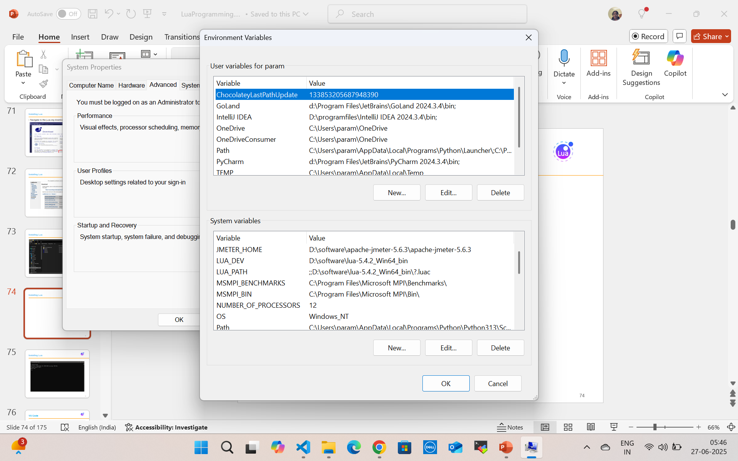

Installing Lua

Slide 75
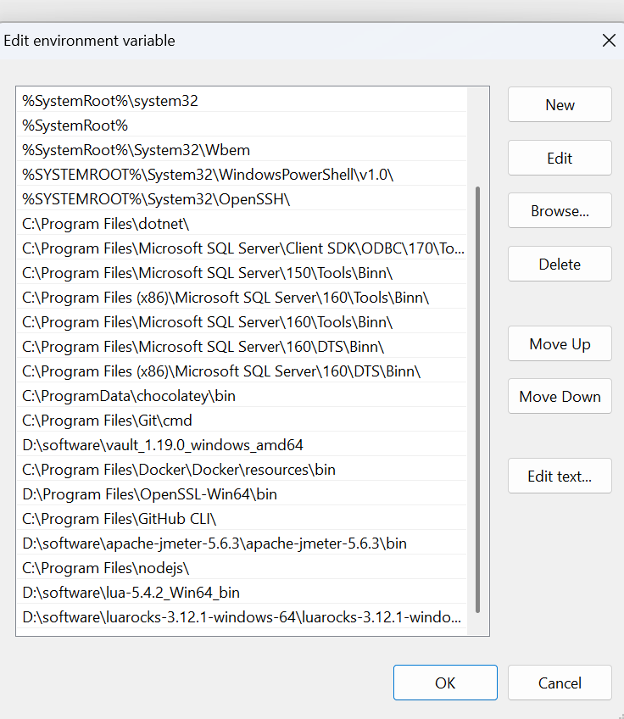

Installing Lua

Slide 76
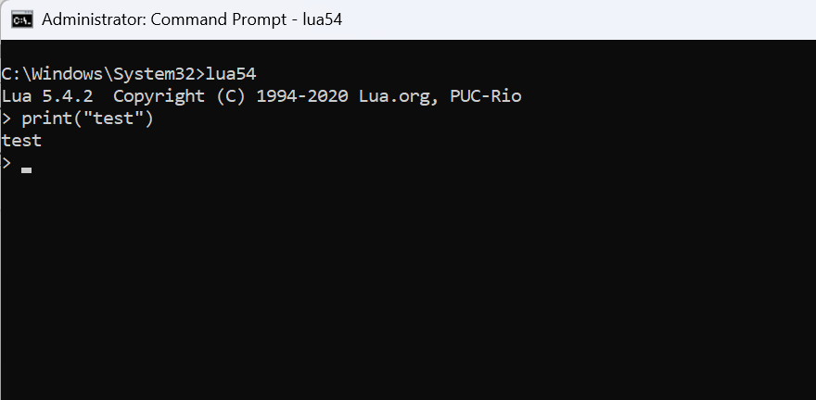
Installing Lua

Slide 77
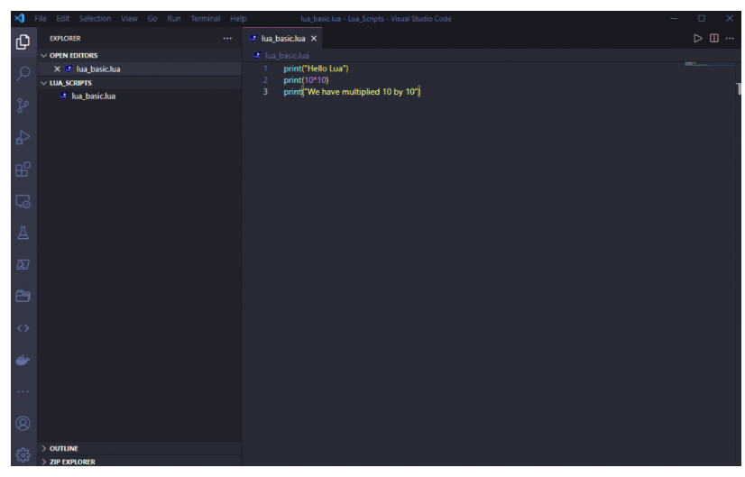
VS Code

Slide 78
1. What Is a Chunk?
In Lua, a chunk is the fundamental unit of execution — a compilable and executable block of code.
Internally, a chunk is compiled into a function prototype (Proto) which is managed by the Lua virtual machine (VM).
This allows Lua to treat chunks as first-class functions.

Slide 79
1. What Is a Chunk?
In Lua, a chunk is the unit of execution — essentially, any piece of Lua code that can be executed.
This includes:
A file loaded via dofile, loadfile, or require
A string loaded via load, loadstring, or luaL_loadstring (in C)
Inline code passed to the interpreter

Slide 80
1. What Is a Chunk?
A chunk can be:
A Lua file (e.g., myscript.lua)
A string of Lua code (e.g., from load() or loadstring() in older versions)
A bytecode block (precompiled with luac)
-- File as a chunk
dofile("myscript.lua")
-- String as a chunk
load("print('Hello from chunk')")()

Slide 81
1. What Is a Chunk?
When executed, a chunk behaves like an anonymous function:
It can contain statements and expressions.
It can return values.
It can define local/global variables, functions, etc.

Slide 82
Internals of a Lua Chunk
1. Definition
A chunk is:
A file or string of Lua code
Parsed by the Lua compiler
Translated into bytecode (for the Lua VM)
Executed as a Lua closure

Slide 83
Internals of a Lua Chunk
2. Compilation Steps
load("print('hello')")
Internally, this performs:
Lexical analysis → Tokenizes the code
Parsing → Builds an abstract syntax tree (AST)
Code generation → Compiles to a Proto (prototype object)
Closure creation → A C closure wraps the prototype for executionluaL_loadstring(L, "print('hi')");

Slide 84
Internals of a Lua Chunk
2. Compilation Steps
luaL_loadstring(L, "print('hi')");
This pushes a Lua function (closure) on top of the stack, compiled from a hidden internal Proto struct.

Slide 85
Chunk as Anonymous Function
A chunk is treated like:
function(...)
-- chunk code here
end
That’s why you can:
Use return at top-level
Store chunks in variables or pass them as functions
Expect local variables inside a chunk to die after execution

Slide 86
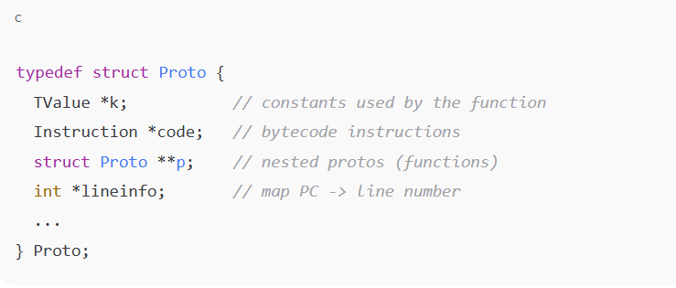
Internal Structure (Proto)
Lua represents a compiled chunk with the Proto structure (from lobject.h in Lua's C source):

Slide 87
Internal Structure (Proto)
Each compiled chunk stores:
Constants (k) – literals, strings, numbers
Bytecode instructions (code)
Nested functions (p)
Debug info – line mapping, local variable names

Slide 88
Execution Process
print("Lua internals")
Lua internally does:
Parse → AST
Compile → Proto
Wrap in LClosure (Lua closure)
Push closure onto the stack
Call using lua_pcall

Slide 89
Summary
Feature | Description
Chunk | Executable block of Lua code
Compiled into | Function prototype (Proto)
Runtime form | Lua closure (LClosure)
Scope | Local (lexical) scope per chunk
Stored in | Constants table, bytecode, debug info
Use cases | Scripts, modules, REPL input, sandbox

Slide 90
Why to use chunk
Modularize code (each module is a chunk)
Dynamically load and execute Lua code
Sandbox execution
Lua’s REPL runs one chunk at a time

Slide 91
Lexical Scoping in Chunks
Each chunk creates its own scope:
load("local x = 42")()
print(x) -- nil; x was local to the chunk

Slide 92
2. How Chunks Are Executed
Internally:
Source code is parsed into an Abstract Syntax Tree (AST).
AST is compiled into bytecode (Proto object).
Bytecode is executed by the Lua Virtual Machine (VM).
This is managed through:
lua_load(): compiles a chunk.
lua_pcall(): calls the compiled function safely.

Slide 93
Types of Chunks
Type | Example | Function
File Chunk | dofile("my.lua") | Executes the entire file
String Chunk | load("x = 2 + 3")() | Compiles and runs the string
Binary Chunk | Precompiled via luac -o a.luac | Faster loading in production

Slide 94
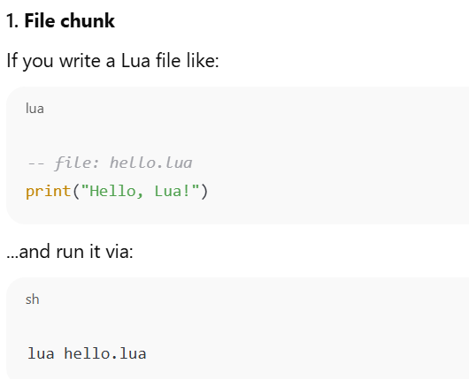
Types of Chunks

Slide 95
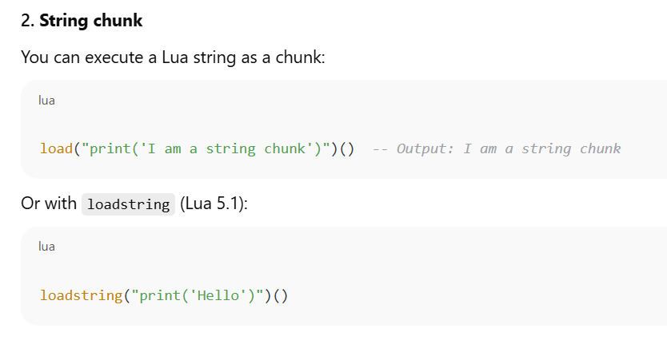
Types of Chunks

Slide 96
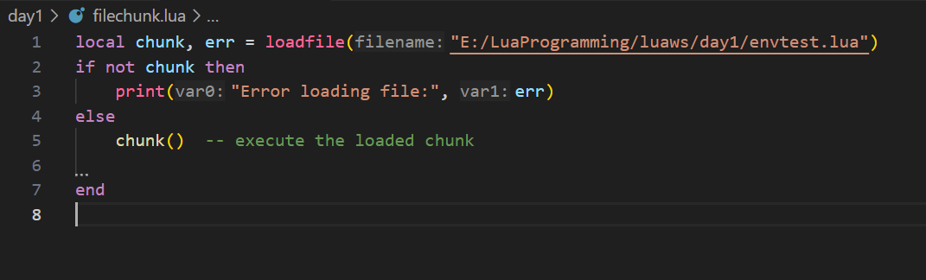
File Chunk

Slide 97
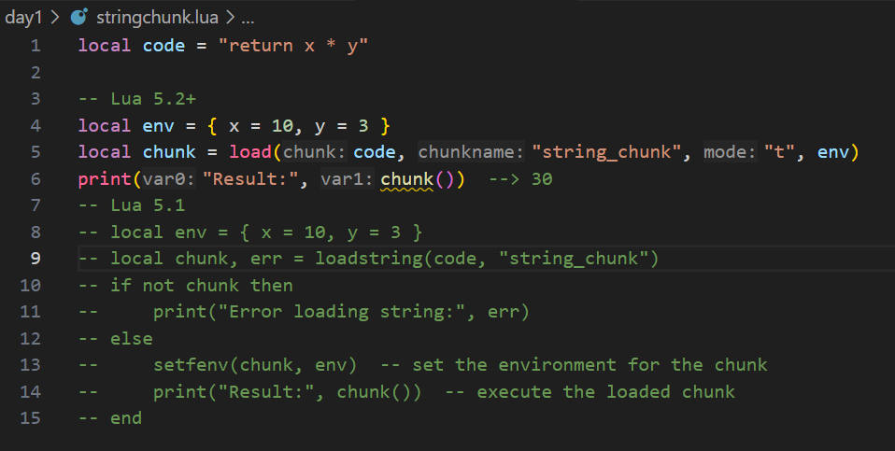
String Chunk

Slide 98
Binary Chunk
A binary chunk in Lua is a precompiled version of a Lua script. Instead of saving your code as plain .lua, you compile it into a bytecode file using the luac compiler.
🧠 This is useful for:
Speeding up loading (faster than parsing)
Obfuscating source code (not readable as text)
Embedding Lua code into applications

Slide 99
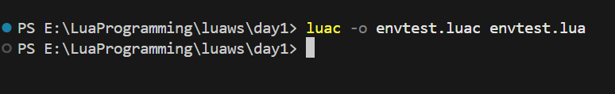
Binary Chunk - Compile to binary chunk using luac
luac -o mychunk.luac myscript.lua

Slide 100
Binary Chunk – How to load Binary Chunk
local chunk = loadfile("mychunk.luac")
if chunk then
local result = chunk()
print("Result:", result)
else
print("Failed to load binary chunk.")
end

Slide 101
Chunk Structure
Every chunk behaves like the body of an anonymous function:
-- top-level chunk
local x = 10
print(x)
Is internally
return function()
local x = 10
print(x)
end

Slide 102
Chunk Structure
Chunks from C (via C API)
luaL_loadstring(L, "print('From C chunk')"); // Compiles chunk
lua_pcall(L, 0, 0, 0); // Executes chunk

Slide 103
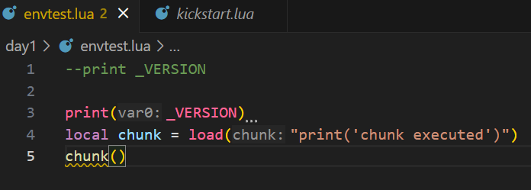
Chunks Are Functions
When a chunk is loaded, Lua wraps it in an anonymous function:
local f = load("return 2 + 2")
print(f()) -- prints 4
You can assign this to variables or call it later.
The chunk inherits the environment it's executed in (_ENV).

Slide 104
Chunk Environments
In Lua 5.2+, chunks run in a specific environment using the _ENV table:
_ENV = { print = print }
load("print('Hello')")() --> OK
-- Limiting environment
load("os.exit()")() --> Error if `os` is not in _ENV
In Lua 5.1, environments were set with setfenv.

Slide 105
Precompiled Chunks (Bytecode)
Use luac to compile:
luac -o mychunk.luac mychunk.lua
Load it in Lua:
dofile("mychunk.luac")
This skips parsing and speeds up execution but reduces portability across Lua versions.

Slide 106
Example: Lua Code → Compilation Flow (Source → Bytecode)
Lexer → Tokens
↓ (lparser.c)
Parser → AST
↓ (lcode.c)
CodeGen → Bytecode (Proto)
↓ (lvm.c)
Execution in Lua VM
Chunk (source code)
↓ (llex.c)

Slide 107
Practical Use Cases
Dynamic evaluation: load() code at runtime
Code sandboxing: run chunks in restricted environments
Plugin systems: load custom logic from files or DB
Optimization: use luac to speed up load time

Slide 108
Lua Lexical Conventions & Global Variables
Lexical conventions define the syntax rules of the language — how tokens (keywords, variables, operators, etc.) are formed and recognized.
Understanding these is essential for writing valid Lua code and managing global/local variables properly.

Slide 109
Lexical Elements in Lua
Element | Description
Identifiers | Names for variables, functions, etc.
Keywords | Reserved words like if, then, end
Operators | +, -, .., ==, etc.
Separators | (, ), {, }, ,, ;, etc.
Literals | Numbers, strings, booleans, nil
Comments | -- line, --[[ block ]]

Slide 110
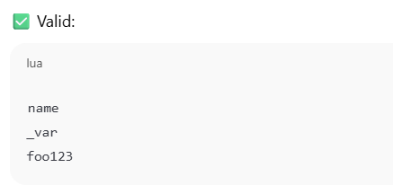
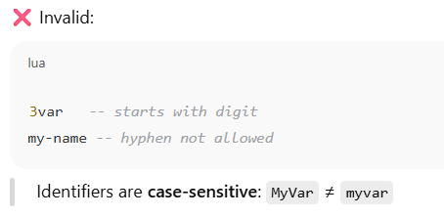
Identifiers
Used to name variables, functions, tables, etc.,
Used to name variables, functions, tables, etc.,
Rules:
Must start with a letter (A–Z, a–z) or underscore_
Followed by letters, digits, or underscores

Slide 111
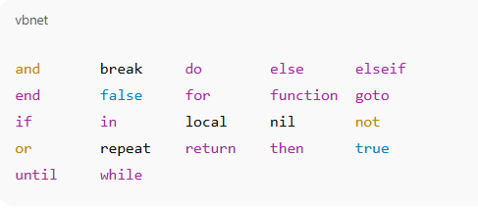
Keywords in Lua
Cannot be used as keywords

Slide 112
Global Variables
By default, any variable assigned without local is global.
x = 10 -- global
local y = 5 -- local
print(x, y)

Slide 113
Accessing/Modifying Globals Programmatically
Lua stores all global variables in the _G table:
x = 42
print(_G["x"]) --> 42
_G["newVar"] = "Hello"
print(newVar) --> Hello

Slide 114
Literals
Numbers: 10, 3.14, 0xFF
Strings: 'hello', "world", [[multiline]]
Booleans: true, false
Nil: nil (absence of a value)

Slide 115
Comments
-- single-line comment
--[[
multi-line comment
]]

Slide 116
Types and Values Nil Booleans
Lua: Types and Values Overview
Lua has 8 basic types
nil
Boolean
Number
String
Function
Userdata
Thread
table

Slide 117
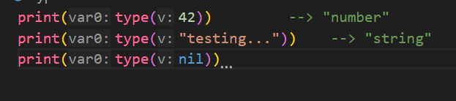
Type Checking

Slide 118
Type: nil
Represents the absence of a value or non-existence.
Used to delete table entries or mark uninitialized variables.
local x
print(x) --> nil
x = nil -- explicitly clearing a variable
Accessing a non-existent global returns nil
print(someUndefinedVar) --> nil

Slide 119
Type: boolean
Lua uses boolean values:
true
False
Only false and nil are falsy
Everything else (even 0 and "") is treated as true.

Slide 120
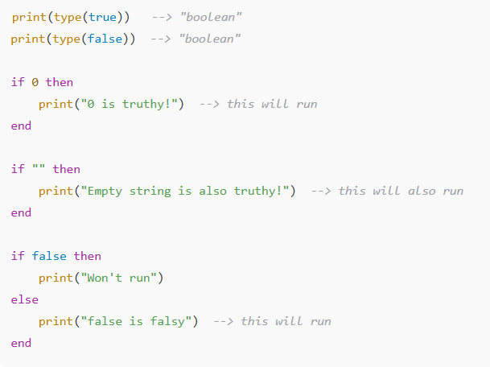
Type: boolean

Slide 121
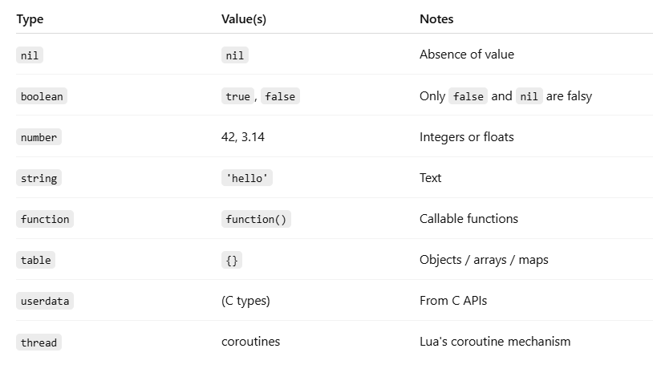
Summary Table

Slide 122
Standalone Interpreter
The Stand-Alone Interpreter typically refers to the command-line version of a language interpreter.
It runs independently, without requiring embedding into another application or development environment.

Slide 123
Definition
A stand-alone interpreter is an executable program that:
Reads code (from files or directly from standard input),
Parses and executes the code line-by-line or as a whole script,
Requires no additional embedding in another application.

Slide 124
Examples of Stand-Alone Interpreters
Language | Interpreter Command | Description
Lua | lua | The stand-alone Lua interpreter that executes .lua scripts.
Python | python / python3 | Runs .py files or opens an interactive shell.
Ruby | irb / ruby | Executes .rb files or opens an interactive Ruby shell.
Node.js (JavaScript) | node | Runs .js files or opens a JavaScript REPL.

Slide 125
Lua Example (Stand-Alone Interpreter)
lua myscript.lua
lua
> print(“Ticking…")
lua is the stand-alone interpreter.
It reads the file or user input and executes Lua code directly.

Slide 126
Features of Stand-Alone Interpreters
✔️ Simple and fast setup
✔️ Useful for scripting, testing, and automation
✔️ Portable across systems (especially with small interpreters like Lua)
❌ May lack the full capabilities of integrated environments or frameworks

Slide 127
Use Cases
Running simple scripts or automation tasks
Quick prototyping or interactive debugging
Embedding logic in command-line utilities
Learning and experimenting with code

Slide 128
Numerals – In Programming and Scripting (e.g., Lua, Python)
Numerals refer to the number literals used to represent numeric values directly in the code.

Slide 129
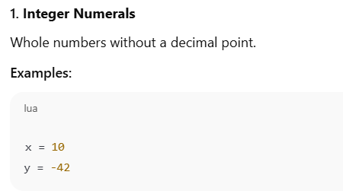
Types of Numerals

Slide 130
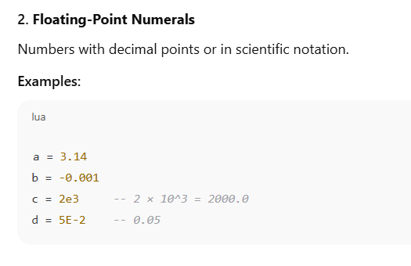
Types of Numerals

Slide 131
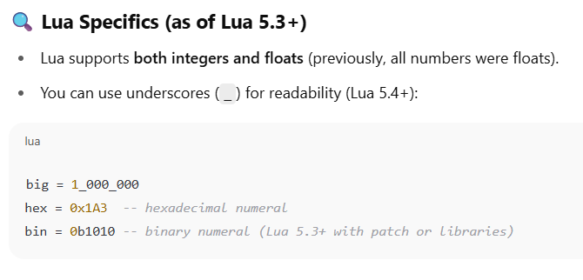
Types of Numerals

Slide 132
Types of Numerals
Language | Integer Example | Float Example | Scientific Notation
Python | x = 42 | y = 3.14 | z = 1.5e2
JavaScript | let a = 10; | let b = 2.5; | let c = 1.2e-3;
C | int x = 5; | float y = 6.7; | double z = 3.0e4;

Slide 133
Arithmetic Operators
Operator | Description | Example (Lua/Python) | Result
+ | Addition | 5 + 3 | 8
- | Subtraction | 9 - 4 | 5
* | Multiplication | 7 * 2 | 14
/ | Division | 10 / 2 | 5.0
// | Floor Division | 10 // 3 (Python) | 3
% | Modulus (Remainder) | 10 % 3 | 1
^ | Exponentiation | 2 ^ 3 (Lua) | 8
** | Exponentiation | 2 ** 3 (Python) | 8
-x | Negation (Unary) | -7 | -7

Slide 134
Relational Operators
Operator | Meaning | Example (Lua/Python) | Result
== | Equal to | 5 == 5 | true
~= | Not equal to (Lua) | 5 ~= 3 | true
!= | Not equal to (Python) | 5 != 3 | true
> | Greater than | 7 > 4 | true
< | Less than | 3 < 9 | true
>= | Greater than or equal | 6 >= 6 | true
<= | Less than or equal | 5 <= 8 | true

Slide 135
Example in Lua
print(4 + 5) --> 9
print(10 % 3) --> 1
print(2 ^ 3) --> 8
print(5 == 5) --> true
print(6 ~= 7) --> true
print(3 > 1) --> true

Slide 136
The Mathematical Library
Lua provides a standard math library under the global math table.
It includes functions for:
Arithmetic
Trigonometry
Exponentiation/logarithms
Rounding
Random number generation

Slide 137
Random-Number Generator Functions
Function | Description | Example
math.random() | Random float in range (0,1) | math.random()
math.random(n) | Integer in range [1, n] | math.random(10)
math.random(m, n) | Integer in range [m, n] | math.random(5, 15)
math.randomseed(x) | Seed the random generator (important for reproducibility) | math.randomseed(os.time())

Slide 138
Rounding Functions
Function | Description | Example
math.floor(x) | Rounds down to the nearest integer | math.floor(2.8) → 2
math.ceil(x) | Rounds up to the nearest integer | math.ceil(2.2) → 3
math.abs(x) | Absolute value | math.abs(-5) → 5
math.modf(x) | Splits number into integer + fraction | math.modf(5.75) → 5, 0.75
math.max(a, b) | Max of values | math.max(3, 8) → 8
math.min(a, b) | Min of values | math.min(3, 8) → 3

Slide 139
Summary
Use math.random() for random values, and seed with math.randomseed().
Use math.floor, math.ceil, math.modf for rounding operations.
These functions are part of Lua’s math library, which must not be imported manually — it's available by default.

Slide 140
Representation Limits Conversions Precedence
Representation in Lua
Primitive Types in Lua:
Lua has a few basic types:
Number
String
Boolean
Nil
table (Lua’s primary data structure)
function, thread, and user data

Slide 141
Representation Limits Conversions Precedence
Representation in Lua
Numbers:
Since Lua 5.3, there are two numeric types:
Integer (e.g., 42)
Float / Number (e.g., 3.14)
print(type(5)) --> integer
print(type(5.0)) --> number (float)
Behind the scenes:
Uses IEEE 754 double-precision floating point for number
Uses 64-bit signed integers for integer

Slide 142
Representation Limits Conversions Precedence
Representation in Lua
Limits
Integer Limits:
Lua integers are 64-bit signed integers.
print(math.maxinteger) --> 9223372036854775807
print(math.mininteger) --> -9223372036854775808

Slide 143
Representation Limits Conversions Precedence
Representation in Lua
Floating Point (number):
Min: ~-1.8e308
Max: ~1.8e308
Smallest > 0: 2^-1022 (~2.2e-308)
Special values:
math.huge,
-math.huge,
0/0 (NaN)
print(math.huge) --> inf
print(1/0) --> inf
print(0/0) --> nan

Slide 144
Representation Limits Conversions Precedence
Conversions in Lua
Automatic Conversions:
print("5" + 2) --> 7 (string "5" is converted to number)
print(10 .. 20) --> "1020" (number is converted to string for concatenation)
Explicit Conversions:
tonumber("123") --> 123
tostring(456) --> "456"
Caution:
print("hello" + 1) --> error: attempt to perform arithmetic on a string value

Slide 145
Operator Precedence in Lua
Precedence | Operators | Type
1 (highest) | ^ | Exponentiation
2 | not, #, unary - | Unary operators
3 | *, /, //, % | Multiplicative
4 | +, - | Additive
5 | .. | Concatenation
6 | <, >, <=, >=, ==, ~= | Relational
7 | and | Logical AND
8 | or | Logical OR
9 (lowest) | Assignment (via =) | Not an operator

Slide 146
Operator Precedence in Lua
print(2 + 3 * 4) --> 14 (multiplication first)
print(2 ^ 3 ^ 2) --> 512 (right-associative)
print("a" .. "b" .. "c")--> "abc" (right-associative)

Slide 147
Lua Before Integers
Prior to Lua 5.3, Lua had only one numeric type:
📌 number — implemented as IEEE 754 double-precision floating-point (64-bit float).
There was no separate integer type, so all numbers were floats.

Slide 148
Lua Before Integers
Representation of Numbers (Lua ≤ 5.2)
Lua stored all numeric values as floating-point numbers:
Accurate up to 15–17 significant digits.
Could represent very large or very small numbers.
But not ideal for exact integers when very large (e.g., 2^53+1 is not precisely represented).
print(type(5)) --> number
print(5.0 + 0.1) --> 5.1

Slide 149
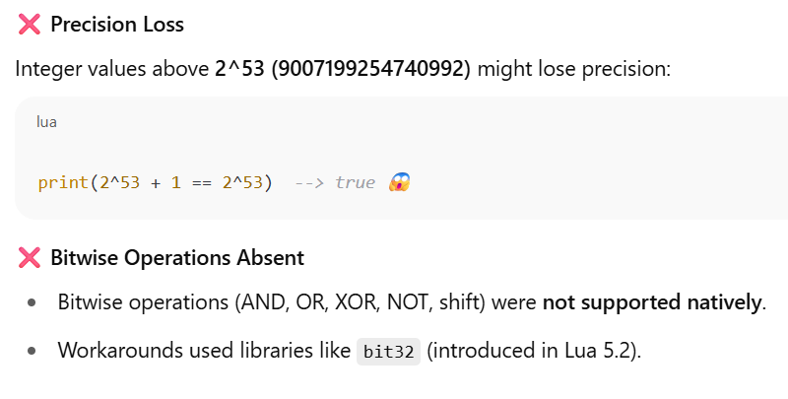
Lua Before Integers
Representation of Numbers (Lua ≤ 5.2)
Issues Before Integers

Slide 150
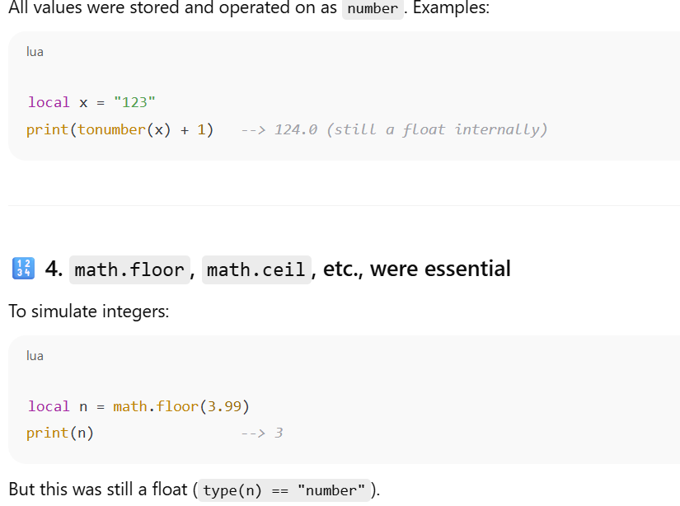
Lua Before Integers
Conversions Were All Float-Based

Slide 151
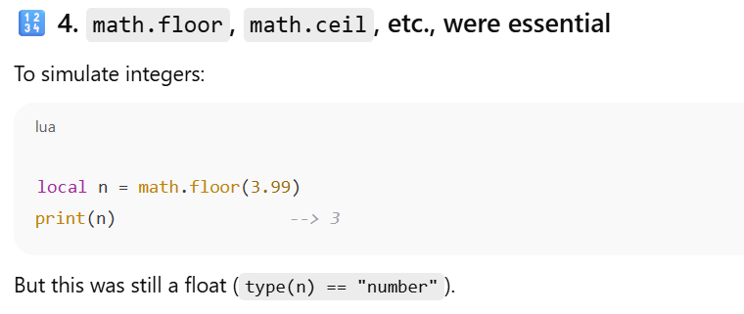
Lua Before Integers
Conversions Were All Float-Based

Slide 152
What Changed in Lua 5.3+
Feature | Lua ≤ 5.2 | Lua 5.3+
Numeric type | number (float) | number + integer
Integer precision | Limited by float | Exact 64-bit integers
Bitwise operations | ❌ (use libraries) | ✅ Built-in (&, `
Distinction in type() | No | Yes (type(1) → "integer")

Slide 153
Literal strings Long strings Coercions
Literal Strings in Lua
Definition:
A literal string is text enclosed in single (') or double quotes (").
Lua allows interchangeably.
local a = 'Hello'
local b = "World"
print(a .. " " .. b) --> Hello World

Slide 154
Literal strings Long strings Coercions
Escapes in Literal Strings:
Lua supports escape sequences:
\n → newline
\t → tab
\\ → backslash
\" or \' → quote
print("Line1\nLine2") --> Line1 (newline) Line2

Slide 155
Long Strings in Lua
Definition:
Enclosed using double square brackets: [[ ... ]]
Used to avoid escaping characters and for multi-line strings.
local msg = [[
This is a long
multi-line string.
It preserves formatting!
]]
print(msg)

Slide 156
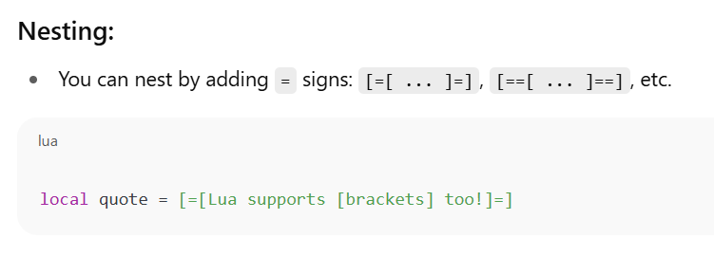
Long Strings in Lua

Slide 157
Coercions in Lua
Definition:
Coercion is an automatic conversion between types when needed (e.g., string ↔ number).

Slide 158
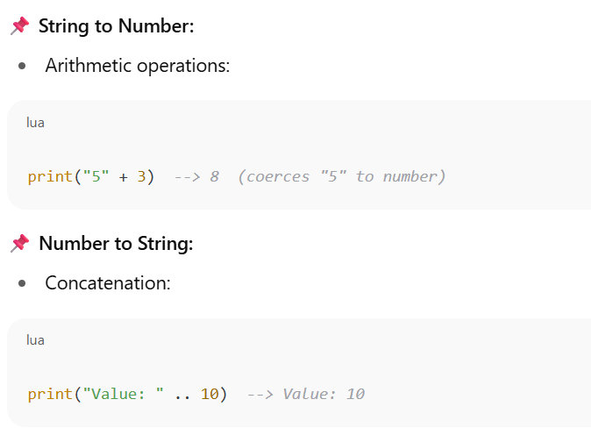
Coercions in Lua
When does coercion happen?

Slide 159
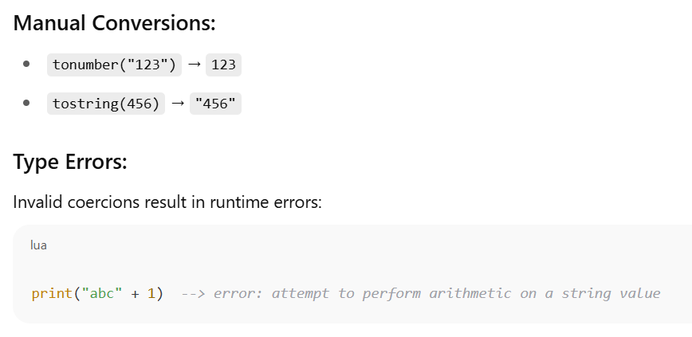
Coercions in Lua

Slide 160
Summary Table
Feature | Syntax | Notes
Literal String | 'text', "text" | Escape sequences allowed
Long String | [[text]], [=[text]=] | Multi-line, raw, no escapes
Coercion (Auto) | "5" + 3, "value" .. 10 | String ↔ Number (when needed)
Coercion (Manual) | tonumber(), tostring() | Safer and explicit

Slide 161
The String Library & Unicode in Lua
Lua has a powerful built-in string library.
Lua does not natively support full Unicode strings—it treats all strings as byte sequences.

Slide 162
The string Library in Lua
Function | Description
string.len(s) | Returns length (in bytes) of s
string.sub(s, i, j) | Substring from position i to j
string.upper(s) | Convert to uppercase
string.lower(s) | Convert to lowercase
string.reverse(s) | Reverse string
string.rep(s, n) | Repeat string n times
string.find(s, pattern) | Find substring or pattern match
string.match(s, pat) | Returns first match for pattern
string.gsub(s, pat, repl) | Global substitution (replace all matches)
string.byte(s, i) | Byte value at position i
string.char(n) | Character from byte value n

Slide 163
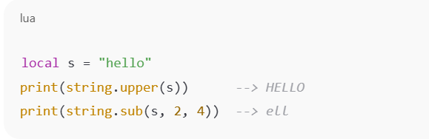
The string Library in Lua

Slide 164
Unicode in Lua
Lua strings are byte-based, not character-based.
"ñ" in UTF-8 is two bytes: 0xC3 0xB1
string.len("ñ") returns 2, not 1

Slide 165
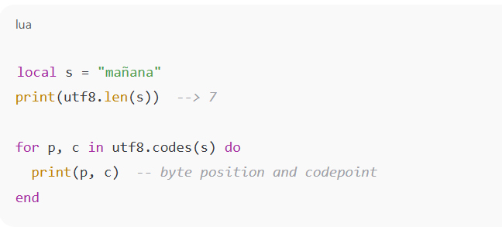
Handling Unicode (UTF-8) in Lua
Function | Description
utf8.len(s) | Number of UTF-8 characters
utf8.codes(s) | Iterator over Unicode code points
utf8.char(n) | Convert code point to character
utf8.codepoint(s) | Returns code point(s) of UTF-8 chars

Slide 166
ASCII vs Unicode
local s = "é" -- 'e' + combining acute accent (U+0301)
print(string.len(s)) --> 3 (in bytes)
print(utf8.len(s)) --> 2 (in characters)

Slide 167
Summary
Feature | Lua (Default) | Notes
String encoding | Byte sequences | UTF-8 supported but not interpreted
ASCII handling | Works perfectly | 1 byte = 1 char
Unicode (UTF-8) | Use utf8 lib | Lua 5.3+ only
Pattern matching | Byte-level only | Not Unicode-aware

Slide 168
Lua Regex
Pattern | Meaning
. | (dot) matches any character
%a | letters (a-z, A-Z)
%d | digits (0-9)
%s | whitespace
%w | alphanumeric
+ | one or more repetitions
* | zero or more repetitions
- | zero or more (non-greedy)
^ | beginning of string
$ | end of string
[] | set of characters
[^] | negated set

Slide 169
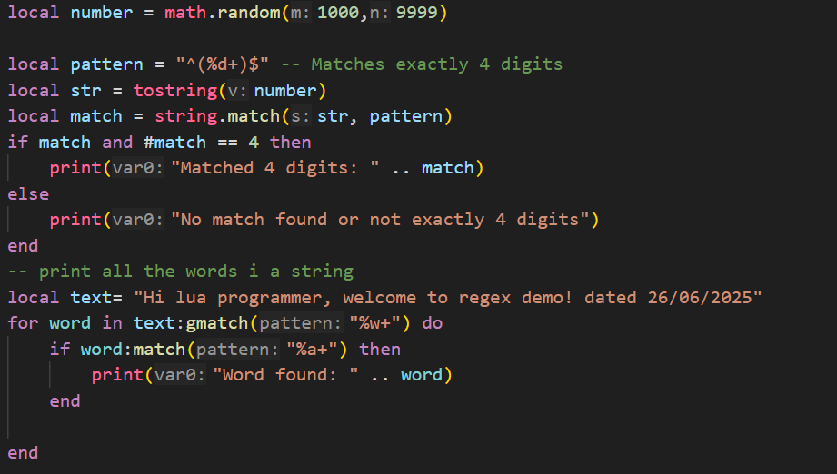
Lua Regex

Slide 170
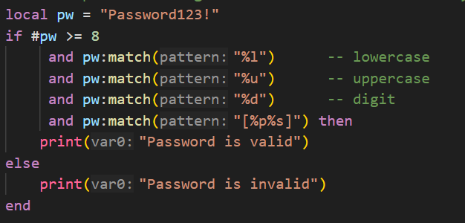
Lua Regex
-- check password using lua has at least 8 characters, one uppercase letter, one lowercase letter, one number, and one special character

Slide 171
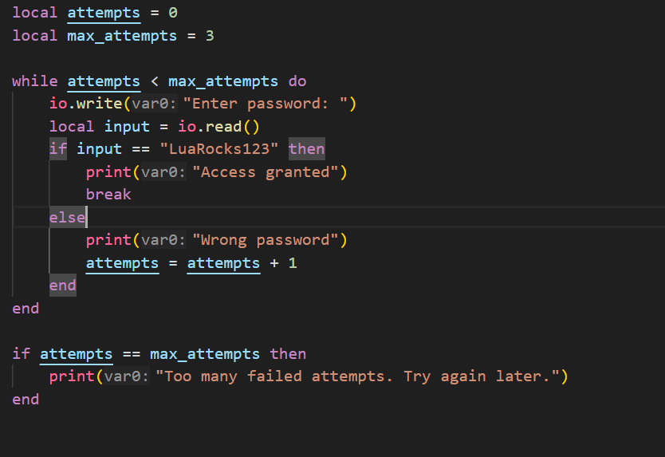
Loops

Slide 172
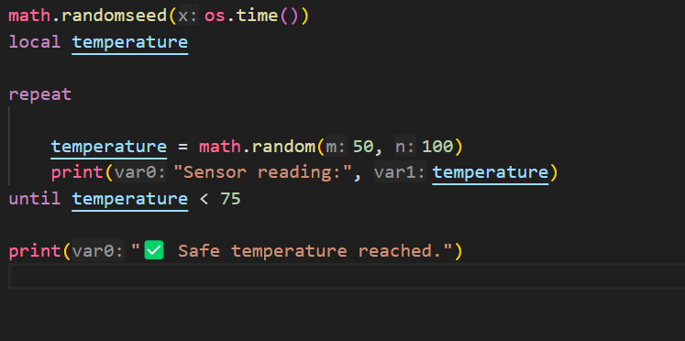
Loops

Slide 173
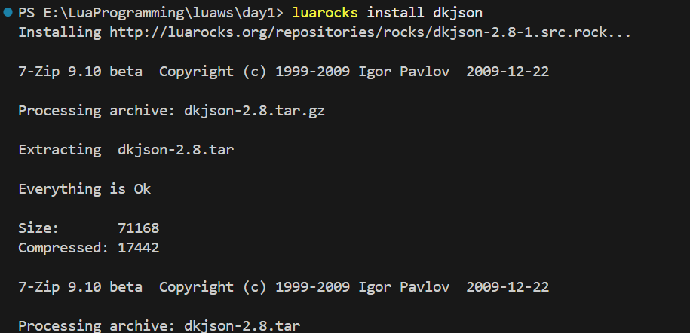
External Libraries
Json Parsing

Slide 174
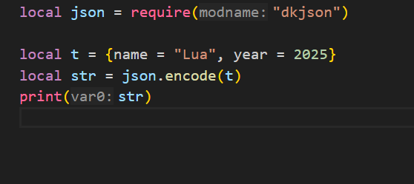
External Libraries
Json Parsing

Slide 175
Module Summary
Lua Getting Started
Numbers
Strings

